Slide 1
Decentralized Identifier URL Specification (did-url-spec)
2019-03-24

Slide 2
Hyperonomy Business Blockchain Decentralized Identifier URL Specification (did-url-spec) https://github.com/mwherman2000/did-url-spec
Michael Herman
Independent Blockchain Architect
mwherman@parallelspace.net

Slide 3
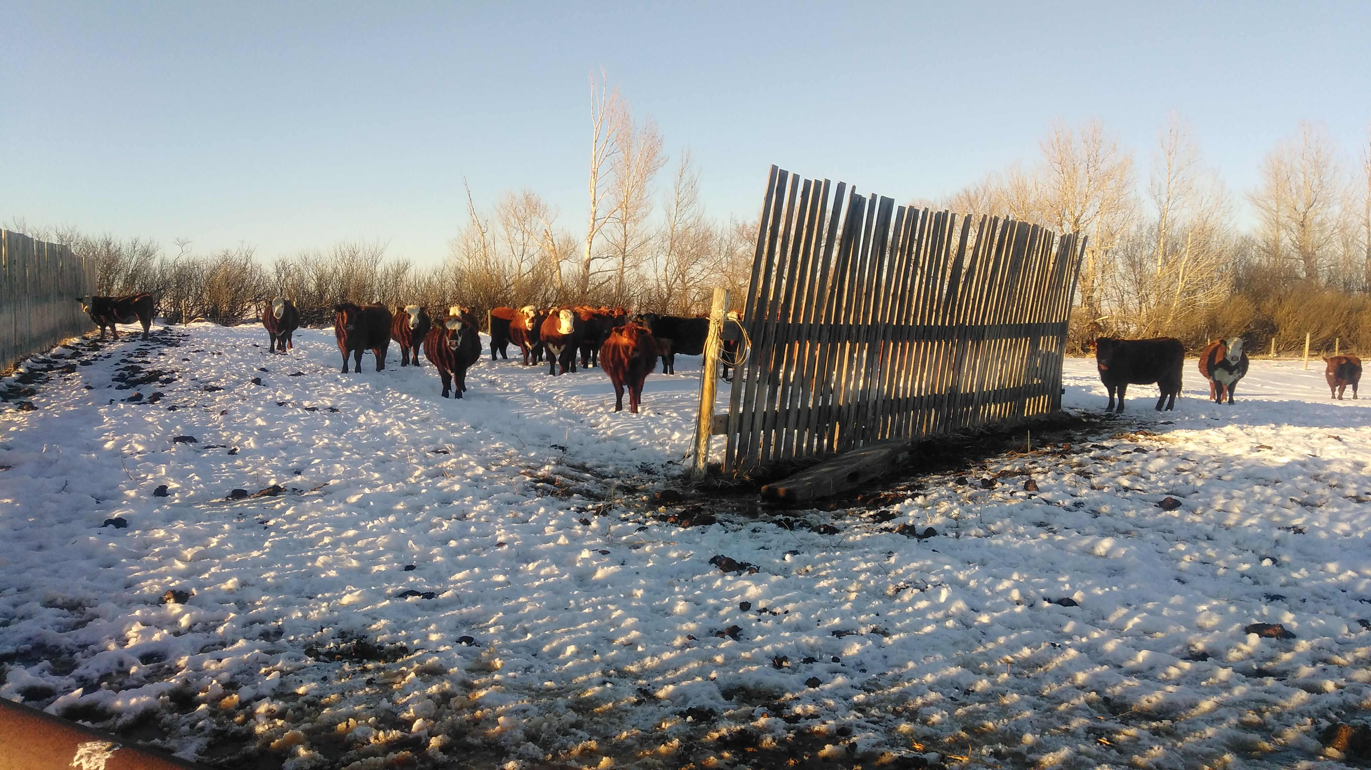
Michael Herman Independent Blockchain Architect Alberta, CANADA

Slide 4
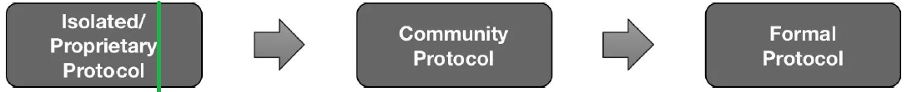
Status
The status of this specification is that it is a work-in-progress community member contribution.
The current intention is for this specification to be merged into the W3C Decentralized Identifiers specification directly, by reference, or as an appendix.

Slide 5
Purpose and Audience
Purpose
The purpose of this specification is to document the development of as well as the final version of the did-url grammar for the Decentralized Identifier URL Specification (did-url-spec).
Audience
The primary audience for this specification is implementors and maintainers of parser software that is compliant with the did-url-spec including but not limited to:
W3C Decentralized Identifier specification
DID Resolvers and DID Resolution
Agent-to-Agent (A2) Communications services in the Hyperledger Indy Agent framework

Slide 6
Goals and Non-goals
Goals
document the development of the did-url-spec version of the did-url grammar
publish the final version of the grammar
Non-goals
It is not a goal of this discussion force any particular project or specifications effort to adopt this specification but it is hoped that this specification significantly influences the current state and all future states of the `did-url` grammar discussions.

Slide 7
Decentralized Identifier URL Specification (did-url-spec) User Scenarios / Applications
W3C Decentralized Identifier specification
DID Resolvers and DID Resolution
Agent-to-Agent (A2) Communications services in the Hyperledger Indy Agent framework
Attachments
Feature discovery
Others?
NOTE
This document is specification specifically for Decentralized Identifier URLs ...described by the did-url grammar using the ABNF notation.
For a better understanding of this terminology, read Giving Grammars Written with ABNF Notation the Respect They Deserve (https://hyperonomy.com/2019/03/11/giving-grammars-written-with-abnf-notation-the-respect-they-deserve/.

Slide 8
Motivation
During the Feb. 21, 2019 DID Resolution community call, there was a early/initial discussion about using an HTTP binding pattern such as:
http://uniresolver.io/resolve/did:xyz:1234
http://uniresolver.io/dereference/did:xyz:1234#key1
It was surprising to see the above pattern being proposed because the resolve and dereference operations are redundant.
I assume that the purpose of the current "DID ABNF" syntax discussions is to encapsulate these types of operations into a did-url grammar. Based on this assumption, the following did-url patterns (and HTTP bindings) are being recommended for use as the primary patterns for the previous 2 use cases:
Resolution: http://uniresolver.io/did:xyz:1234
Dereferencing (general case): http://uniresolver.io/did:xyz:1234#key1 and, optionally, http://uniresolver.io/did:xyz:1234!$selectId="key1"

Slide 9
Approach
The general approach is:
Use the original architectural principles from the draft `did-spec` as well as the higher-level DID user scenarios from several documents (see below) to create a comprehensive list of lower-level did-url use cases for the did-url grammar.
Use the lower-level did-url use cases which in turn can drive the design of the did-url grammar (expressed at a higher level using ABNF notation).
Use the did-url grammar design to drive the implementation (i.e. ABNF source code) for the actual did-url grammar.
Validate the did-url grammar by testing using test cases based on the did-url lower-level use cases.
Iterate.

Slide 10
Guiding Principles (1/2)
Follow the Core Principles expressed in the following documents:
The #OpenToInnovation Principle: Internet protocols and standards not only need to be open, but more importantly, open to innovation (https://hyperonomy.com/2019/03/12/internet-protocols-and-standards-not-only-need-to-be-open-but-more-importantly-open-to-innovation/)
Giving Grammars Written with ABNF Notation the Respect They Deserve (https://hyperonomy.com/2019/03/11/giving-grammars-written-with-abnf-notation-the-respect-they-deserve/)
Ensure that an app developer has the tools he/she needs to be able to effectively search, find, resolve, and dereference:
a single DID Document associated with a DID, or
a collection of DID Documents based on several criteria (defined in the use cases)
Ensure that an app developer has the tools he/she needs to be able to effectively search, find, resolve, dereference, and execute:
a service endpoint associated with a service-id in a single DID Document associated with a DID.

Slide 11
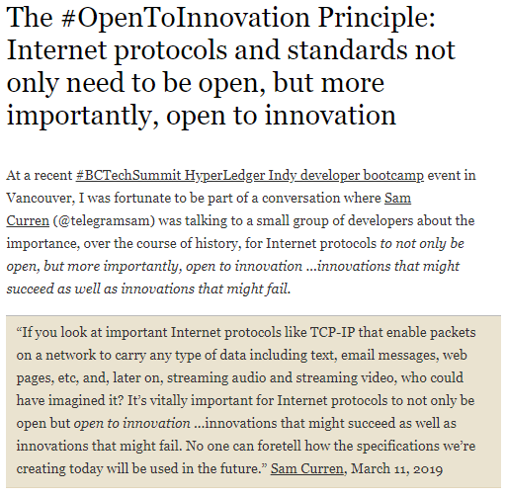
#1.1

Slide 12
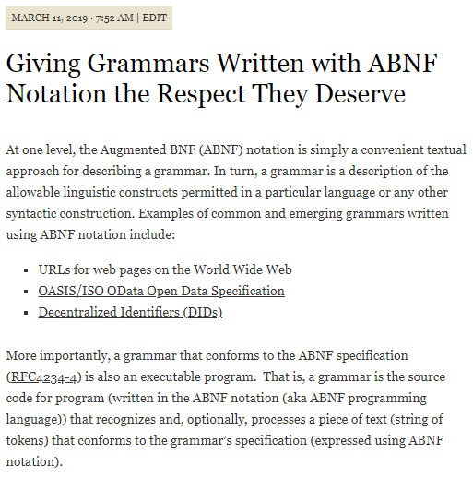
#1.2 (1/3)

Slide 13
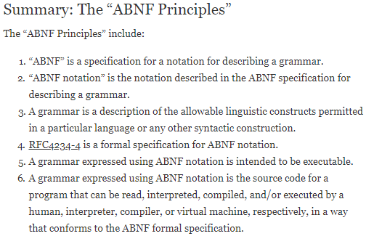
#1.2 (2/3)

Slide 14
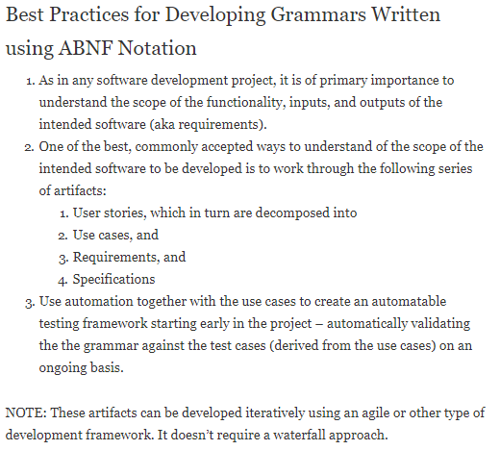
#1.2 (3/3)

Slide 15
Guiding Principles (2/2)
Ensure that the above operations and capabilities are expressed in a consistent did-url syntax - eliminating the need for creating additional language and/or API constructs, where possible.
Ensure that the draft "DID ABNF" supports the above goals and doesn't unnecessarily restrict future innovation with respect to did-url parsing (and DID Resolution, specifically but not exclusively) ...that is, that the "DID ABNF" doesn't restrict the syntax patterns needed for present and future did-url parsing (and DID Resolution, specifically but not exclusively) innovation. This is especially important because the current "DID ABNF" is completely defined in a different specification from the DID Resolution specification (i.e. the DID Specification).
Ensure that an app developer has the tools he/she has the basic operational capabilities available to test if a DID Resolver is alive and responsive, control the format of the DID Resolver response, etc.
The did-url use cases (the lower-level did-url use cases) will be guided/driven by the specific higher-level DID user scenarios documents listed below. See Principle 1.2 above.

Slide 16

 Background
Michael Herman
Independent Blockchain Architect
mwherman@parallelspace.net
2019-03-24

Slide 17
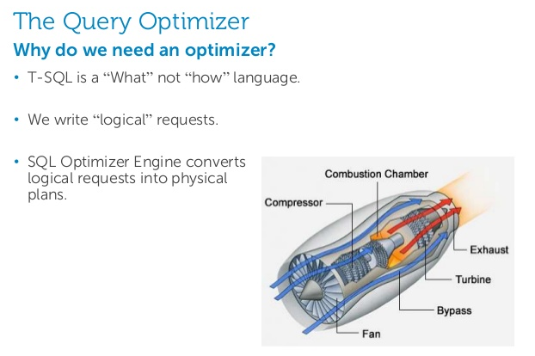
Generic Parsing and Processing (1/3)
Declarative language – not a Functional language

Slide 18
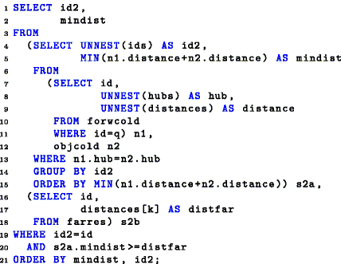
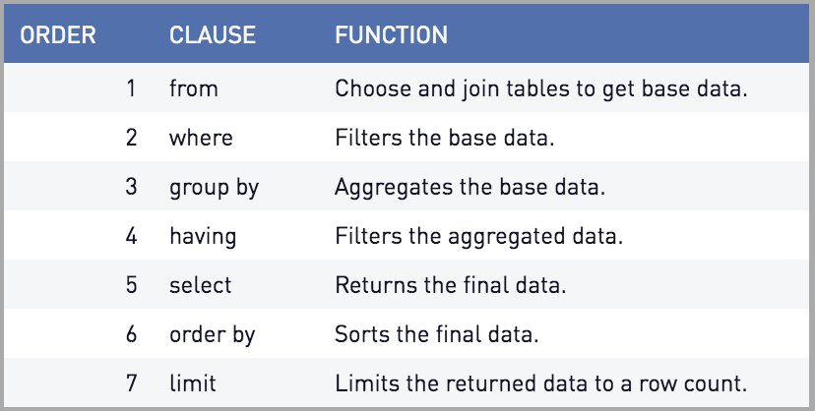
Generic Parsing and Processing: SQL Example
T-SQL is a Declarative language – it describes what is to be returned
T-SQL is not a Functional language – it doesn’t describe how to access or how to enumerate over the data store
Clause Ordering is Declarative – not Functional

Slide 19
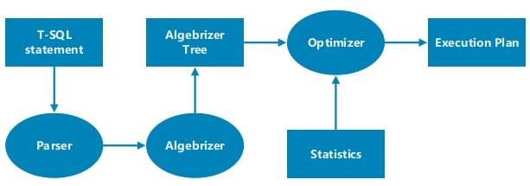
Generic Parsing and Processing Pipeline
Parsing
Processing
Semantic Analysis
Optimization
Execution
T-SQL
Statement
7
did-url
1
Cypher
Statement
4
5
Hard Parse
2
3
6
Soft Parse

Slide 20
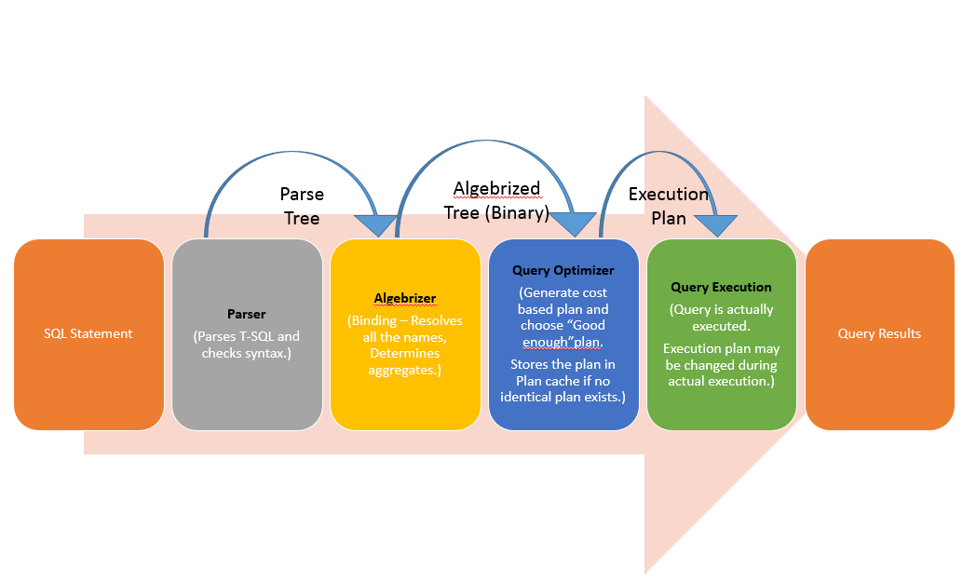
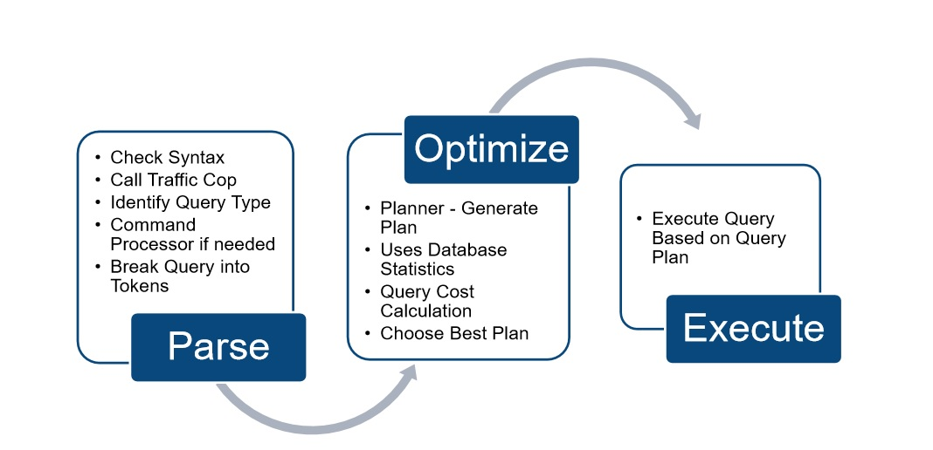
SQL Server Query Execution Flow (T-SQL Query)

Slide 21
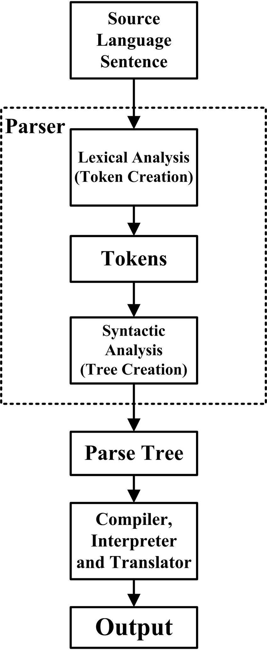
Soft Parse vs. Hard Parse
A Soft Parse is when a did-url is comprised of a did only (with no additional grammar rules (features) specified)
Only physical access optimizations are possible
A Hard Parse is when a did-url is comprised of a did plus additional grammar rules (features)
Additional types of optimizations are possible (e.g. $exist)
Soft
Parse
Hard Parse

Slide 22
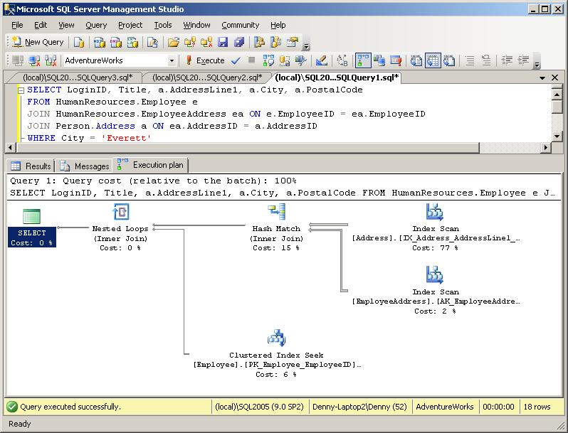
Processing: Execution Plans (T-SQL)

Slide 23
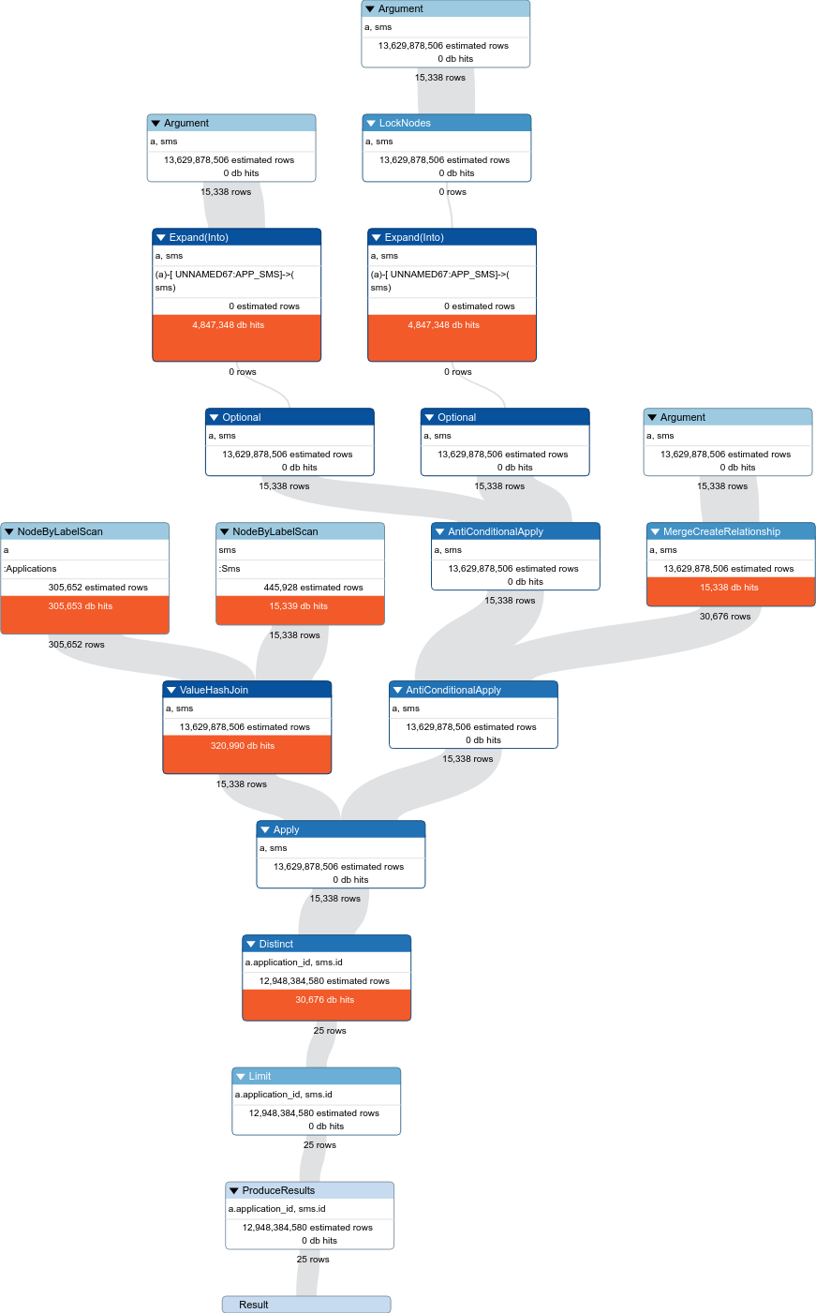
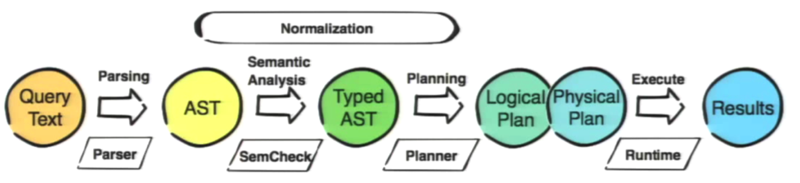
Processing: Execution Plans (Cypher/Neo4J) Neo4j Graph Database
MATCH (a:Applications), (sms:Sms {id: a.application_id})
MERGE (a)-[r:APP_SMS]->(sms)
RETURN distinct a.application_id, sms.id
I have executed the same query with profile and limit 25 to see the query plan and results:
10382692 total db hits in 3219 ms
Credit: https://stackoverflow.com/questions/52465038/merge-query-optimization-neo4j?rq=1

Slide 24
Generic Parsing and Processing (1/2) Sample User Scenarios
T-SQL Query
Parser
Analyser
Optimizer (RDB)
Execution Engine (RDB)
Relational Datastore
Cypher Query
Parser
Analyser
Optimizer (NGDB)
Execution Engine (NGDB)
Neo4j Graph DB
No-SQL Query
Parser
Analyser
Optimizer (NSDB)
Execution Engine (NSDB)
No-SQL Datastore

Slide 25
 did-url Parsing and Processing
Michael Herman
Independent Blockchain Architect
mwherman@parallelspace.net
Decentralized Identifier URL Specification (did-url-spec)
2019-03-24

Slide 26
Generic Parsing and Processing (1/2) Sample User Scenarios
T-SQL Query
Parser
Analyser
Optimizer (RDB)
Execution Engine (RDB)
Relational Datastore
Cypher Query
Parser
Analyser
Optimizer (NGDB)
Execution Engine (NGDB)
Neo4j Graph DB
No-SQL Query
Parser
Analyser
Optimizer (NSDB)
Execution Engine (NSDB)
No-SQL Datastore

Slide 27
Generic Parsing and Processing (2/2) DID User Scenarios
did-url
Parser
Analyser
Optimizer (VDR)
Execution Engine (VDR)
Verifiable Data Registry
did-url
Parser
Analyser
Optimizer (AFD)
Execution Engine (AFDB)
Indy Agent Feature DB
did-url
Parser
Analyser
Optimizer (JSON)
Execution Engine (JSON)
Indy Agent
Message Attachment
Collection
did-url
-
-
-
-
id
Attribute

Slide 28
Generic Parsing and Processing (repeat)
Declarative language – not a Functional language

Slide 29
DID Resolution vs. DID Dereferencing
In recent DID Resolution community discussions (March 2019), DID Dereferencing of a did-url as process that starts with/requires the resolution of the DID Document associated with the did-url and then continues with the dereferencing against the associated DID Document
While it might be true at a very conceptual level for some DID Methods and their corresponding Verifiable Data Registries (VDRs), as a generalization, it’s not true.
did-url’s are expressions similar to any expressions sent through a Parsing and Processing pipeline
did-url’s are logical expressions of describing what is to be returned (in the spirit of RFC3986)
The form, function, and intention of a did-url is to describe what is to be returned; not how it is to be returned.

Slide 30
 An Example
Michael Herman
Independent Blockchain Architect
mwherman@parallelspace.net
Decentralized Identifier URL Specification (did-url-spec)
2019-03-24

Slide 31
did-url Service Endpoint Transformers: Use Cases
H. DID URL Service Endpoint Transformation Use Cases (using "!" transformer (pipe) option and $serviceId transform option)
These following use cases use the "!" transformer (pipe) option and $serviceId transformer (pipe) option (aka $serviceId transformer). These tokens immediately follow is formally the text that matches be the did rule. The semantics are: take the did text (up to the "!" pipe option) and pass it through a transformation represented by the transform options that follow the "!" transformer (pipe) option.
For example, if the transformer is $serviceId="<service-id>", the effect would be to produce the resolved URL/URI for, in this case, the service endpoint corresponding service-id. See the table below for more specific examples of the syntax.
Conceptually, the processing is: did-url | transform(tranformOptions) to produce a transformed-url

Slide 32
did-url Service Endpoint Transformers: Examples
Here's are 2 specific examples based on the Windley examples. These examples also make clear the difference between the transformer approach and the ';' approach. The subject DID document is from Windley article.
Approach Example
Windley did:sov:123456789abcdefghij;exam_svc
Transformer did:sov:123456789abcdefghij!$serviceId="exam_svc"
Both of the above did-url’s resolve (dereference) to the same URI/URL: https://example.com/endpoint/8377464
Approach Example
Windley did:sov:123456789abcdefghij;exam_svc/foo/bar?a=1#flip
Transformer did:sov:123456789abcdefghij!$serviceId="exam_svc"/foo/bar?a=1#flip
Both of the above did-url’s resolve (dereference) to the same URI/URL: https://example.com/endpoint/8377464/foo/bar?a=1#flip

Slide 33
did-url Service Endpoint Transformers: NOTES
NOTE: DID schemes and/or DID Resolvers can define additional transform options. They are not limited by the syntax specification.
NOTE: The ";" token is no longer used anywhere in DID syntax patterns represented across all of the use case categories.
NOTE: Related (and reflecting the views of @dhh128 in comment https://github.com/w3c-ccg/did-spec/pull/168#issuecomment-471655338), there should no longer be a need to use ";' or any special symbol (other than "#") in the id attribute of a service endpoint in a DID Document.

Slide 34
 Use Case Analysis
Michael Herman
Independent Blockchain Architect
mwherman@parallelspace.net
Decentralized Identifier URL Specification (did-url-spec)
2019-03-24

Slide 35
Use Case Analysis
Higher-level DID user scenarios guide/drive the development of the lower-level did-url use cases
Higher-level DID User Scenario Analysis
DID User scenarios
High-level did-url User Scenario Analysis
did-url user scenario
Lower-level did-url Use Case Analysis
did-url use cases

Slide 36
High-level did-url User Scenario Analysis
# | did-url Syntax Patterns | Type of Result
1 | <did> | DID Document
2 | <did>!$selectId=“wxyz” or <did>#wxyz | DID Document Fragment
3 | <did>!$contentId=“pqrs” | DID Document Content Fragment
4 | <did>!$serviceId=“bops” | Remapped Service Endpoint URI/URL
5 | <did>!$attachmentId=“abcd" | DID Document Attachment Fragment
6 | "query": “<did>!$filter='spec/tictactoe/1.*'" | Array of Filtered Service Agent Feature Descriptions
7 | "query": “<did>!$filter='*'" | Array of All Service Agent Feature Descriptions

Slide 37
 Higher-Level DID User Scenarios
Michael Herman
Independent Blockchain Architect
mwherman@parallelspace.net
Decentralized Identifier URL Specification (did-url-spec)
2019-03-24

Slide 38
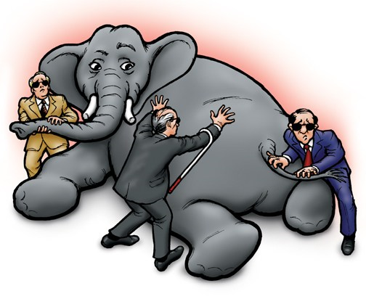
Why Are Higher-Level DID User Scenarios NEEDED?
RFC3986
Blind Men and the Elephant
https://en.wikipedia.org/wiki/Blind_men_and_an_elephant

Slide 39
Higher-Level DID User Scenarios
The following higher-level DID user scenario documents that have been selected to guide/drive the lower-level did-url use cases:
Use Cases for Decentralized Identifiers
https://w3c-ccg.github.io/did-use-cases/
Universal DID Operations
https://github.com/WebOfTrustInfo/rwot8-barcelona/blob/master/topics-and-advance-readings/Universal-DID-Operations.md
Indy draft feature-discovery 1.0 HIPE
https://github.com/dhh1128/indy-hipe/blob/9c7722d208cfe0a336cb67a626cbbb192ae73f8c/text/feature-discovery/README.md
Indy draft attachments HIPE
https://github.com/hyperledger/indy-hipe/blob/bd48bae3712e659c34d88c6dea839ccf5a0f0701/text/attachments/README.md

Slide 40
 Lower-Level did-url Use Cases
Michael Herman
Independent Blockchain Architect
mwherman@parallelspace.net
Decentralized Identifier URL Specification (did-url-spec)
2019-03-24

Slide 41
DID Document Examples
DID Spec - Example 16
INDY-ARM Example
Windley Article Example

Slide 42
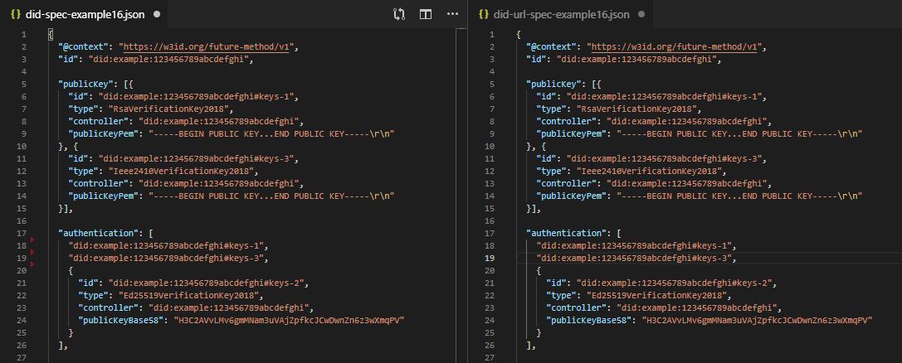
Example 16

Slide 43
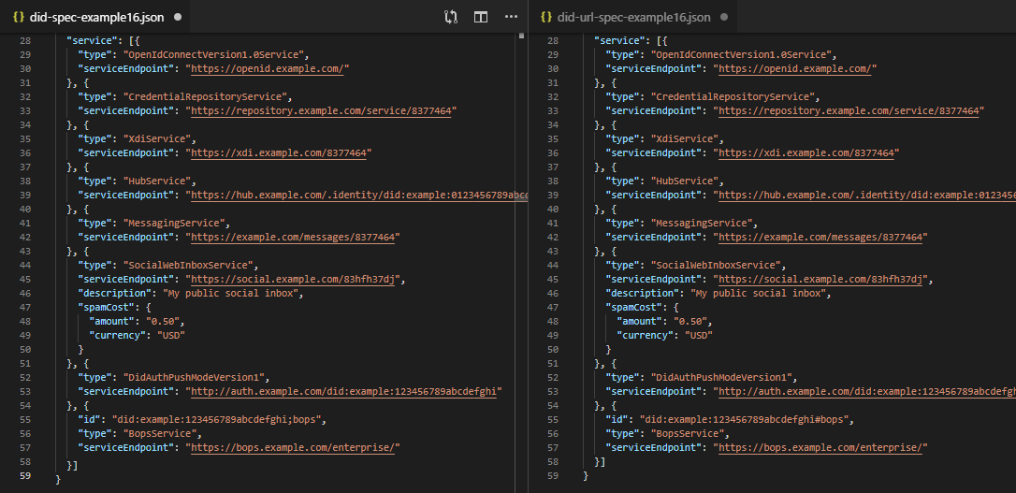
Example 16

Slide 45
Lower-Level did-url Use Cases: B (superseded by H)

Slide 46
Lower-Level did-url Use Cases: C

Slide 48
Lower-Level did-url Use Cases: E

Slide 49
Lower-Level did-url Use Cases: F

Slide 50
Lower-Level did-url Use Cases: G

Slide 51
Lower-Level did-url Use Cases: H

Slide 52
Lower-Level did-url Use Cases: I

Slide 53
Lower-Level did-url Use Cases: J

Slide 54
Lower-Level did-url Use Cases: K

Slide 55
Lower-Level did-url Use Cases: J

Slide 56
 Tooling
Michael Herman
Independent Blockchain Architect
mwherman@parallelspace.net
Decentralized Identifier URL Specification (did-url-spec)
2019-03-24

Slide 57
Grammar-Based Automated Parser Generation
aparse (http://www.parse.com) parser generator
parse2 produces the aParse parser generator that reads Augmented BNF grammars and produces Java, C++ or C# classes that can build parse trees for valid instances of those grammars. aParse is free to download and use without any obligations or limitations.
Using an aParse generated parser, a Java, C++ or C# program can confirm whether a stream of characters represents a valid instance of a particular grammar, for example, a message passed between two programs that should comply with an agreed protocol. The parse tree of a compliant message can be used by the program to process the message content (see the examples for a number of working programs that employ aParse generated parsers).

Slide 58
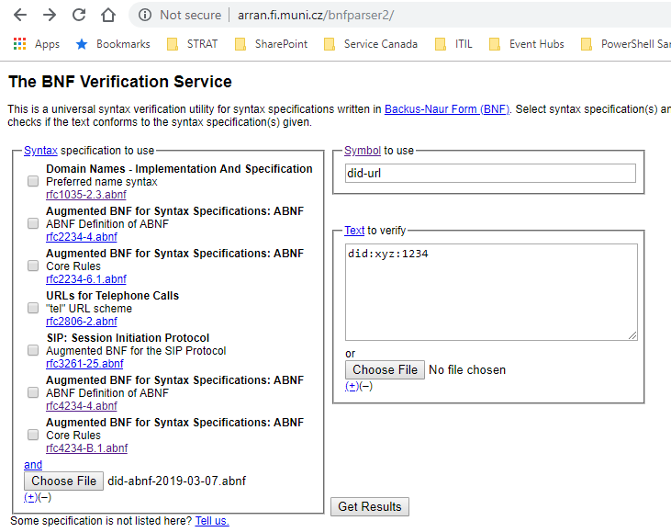
Grammar Testing / Validation
did-url Grammar Validation Tool (Web)
The following web app is being used to validate the did-url grammar against the lower-level use cases: The BNF Verification Service (http://arran.fi.muni.cz/bnfparser2/)

Slide 59
Impacts
Impact on DID Document Grammar
";" is no longer needed/used in a DID Document
From a syntactical perspective, all "anchors" / "selection IDs" are prefixed with a '#' only.
The semantic meaning is determined by the referring did-url transformer.
Impact on Other Specifications
Hyperledger Indy HIPEs
Feature discovery “filter” operator
Attachments id attributes
Others?

Slide 60
 Wrapping UP…
Michael Herman
Independent Blockchain Architect
mwherman@parallelspace.net
Decentralized Identifier URL Specification (did-url-spec)
2019-03-24

Slide 61
Next Steps
Continue to grow and validate the number of higher-level DID user scenarios and, more specifically, lower-level did-url use cases with:
Diverse DID communities
Diverse DID higher-level DID user scenarios
More Indy HIPES
IPID, etc.
Build and test did-url grammar
Using the lower-level did-url use cases as a test cases
Continue to grow the outreach (awareness, knowledge and understanding) of the did-url-spec specification amongst:
Diverse DID communities
Diverse DID higher-level DID user scenario specific scenarios
More Indy HIPES
IPID, etc.

Slide 62
 QUESTIONS?
Michael Herman
Independent Blockchain Architect
mwherman@parallelspace.net
Decentralized Identifier URL Specification (did-url-spec)
2019-03-24

Slide 63
Decentralized Identifier URL Specification (did-url-spec)
2019-03-24

